Slide 1
“Funzionerà.”
The resurrected functionality
of a poor man’s Discord bot
Tod Jones
Dakota Methvin
Vince Seely

Slide 2
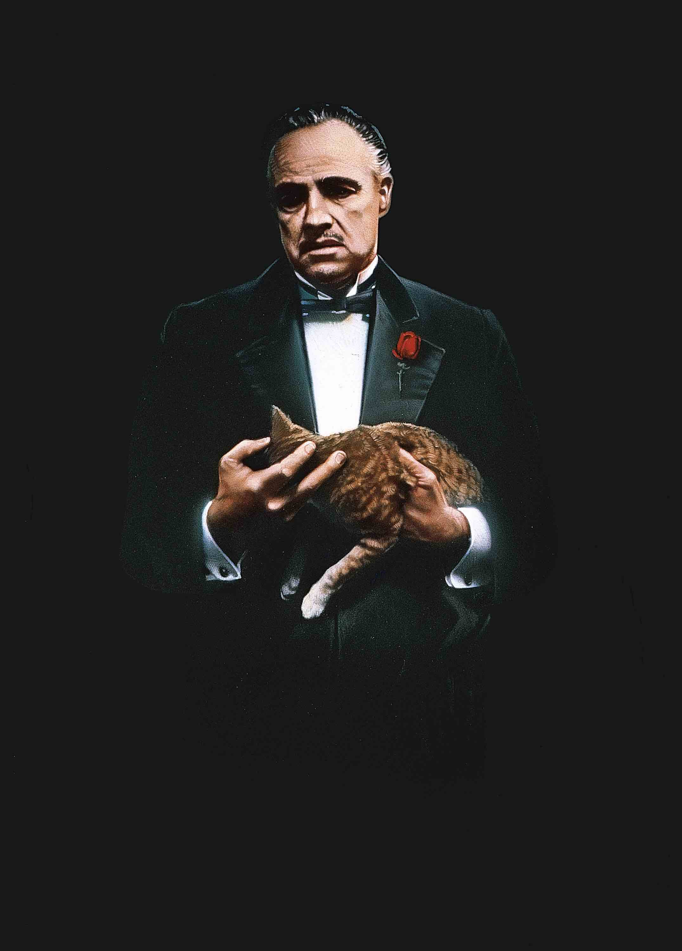
Demo

Slide 3
Questions

